Slide 1
LMRFC Reference Slide For Crest Tables
LMRFC Forecasts Issued Morning of March 9, 2021
Lower Mississippi
RIVER FORECAST CENTER
Talking Points
The lower Ohio River will slowly rise over the next couple of days. Rises from routed water on the Ohio River will continue downstream on the lower Mississippi River over the next 1 to 2 weeks. Minor to isolated moderate flooding continues on the lower Ohio River and isolated minor flooding is either occurring or forecast to occur on the lower Mississippi River.
At the junction of the Ohio and Mississippi Rivers, Cairo, IL continues a broad crest near 46.0ft. Cairo, IL will remain at this level for a couple of more days before starting to fall by the end of the week. The lower Ohio River will continue to be above flood stage over the next 7 days.
On the lower Mississippi River, minor flooding is occurring from Tiptonville, TN to Osceola, AR and minor flooding is expected at New Madrid, MO and Red River Landing, LA during the next several days.
Cresting conditions are still expected at New Orleans, LA for the third week of March.
The 16 day future rainfall guidance is showing another 3 to 5 inches of rainfall over the lower Missouri, middle, Mississippi, and lower Ohio Valleys. The guidance is showing a secondary rise on the lower Ohio for late March and the crest heights would be several feet lower than the current crest. This secondary rise would also prolong flooding for a couple of more weeks.

Slide 2
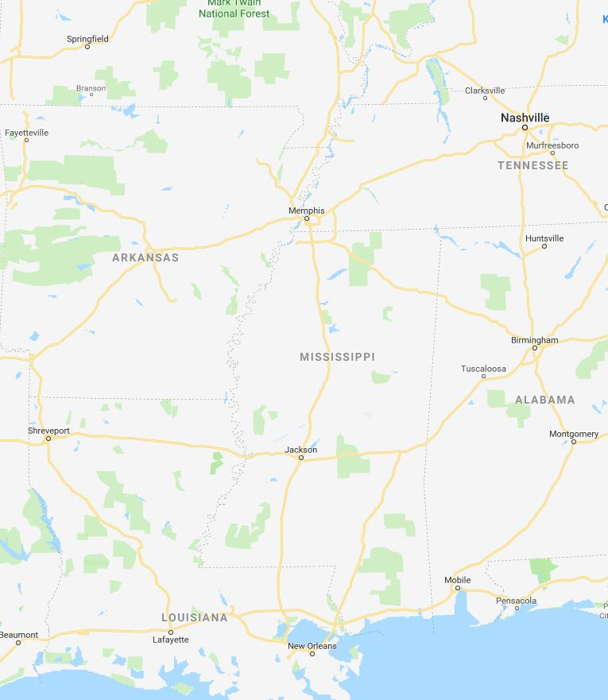
Ohio/Mississippi River Crest Watch
Created March 9 2021 @ 12:00 pm CDT
Lower Mississippi River Forecast Center weather.gov/lmrfc
NWSLMRFC
@NWSLMRFC
MS River at Caruthersville
OH River at Paducah
Current: 34.1’ MINOR
2 Days
Current: 42.7’ MINOR
Forecast:
Crest in MINOR at 34.3’ on March 13th
Forecast:
Crest in MODERATE at 43.0’ on Thursday March 11th
2 Days
0.5 Day
MS River at Memphis
OH River at Cairo
Current: 28.8’ ACTION
Current: 46.1’ MINOR
Forecast:
Crest in ACTION at 29.5’ on March 14th
Forecast:
Near Crest
MS River at Ark City
5 Days
MS River at Greenville
Current: 31.4’
Current: 41.7’ ACTION
Forecast
Crest at 34.0’ on
March 16th
Forecast:
Crest in ACTION at 45.0’
on March 17th
2 Days
1 Day
MS River at Natchez
MS River at Vicksburg
Current: 45.0’ ACTION
Current: 37.6’ ACTION
Forecast:
Crest in ACTION at 47.5’ on March 19th
Forecast:
Crest in ACTION at 40.5’ on March 18th
2 Days
MS River at Baton Rouge
2 Days
MS River at New Orleans
Current: 30.2’ ACTION
Current: 10.6’
Forecast:
Crest in ACTION at
34.0’ on March 21st
Forecast:
Crest at 13.0’ on
March 22nd
Bonnet Carré Location
Morganza Location

