Slide 1
LMRFC Reference Slide For Crest Tables
LMRFC Forecasts Issued Morning of April 6, 2021
Lower Mississippi
RIVER FORECAST CENTER
Talking Points
Dry weather over the past several days is allowing most locations on the lower Ohio and lower Mississippi Rivers to reach crest and start to recede. Minor rises are only occurring from Memphis, TN downstream to Helena, AR and the rises should end over the next couple of days.
Minor to isolated moderate flooding continues on the lower Ohio and lower Mississippi Rivers but all locations from Cairo, IL downstream to Greenville, MS should be below flood stage by early next week.
Minor to isolated moderate flooding will continue on the lower Mississippi River from Vicksburg, MS to Baton Rouge, LA. All locations are receding and flooding should end over the next 2 to 3 weeks.
The lower Mississippi River Valley will start to get into a wetter pattern this week. Right now, the axis of heavy rain is confined to Louisiana and Mississippi and amounts of 2 to 4 inches are forecast during the next week. Where heavier rain bands setup, some locations on the lower Mississippi River could have some temporary rises of a few tenths but the overall trend will be for receding river conditions over the next few weeks.
The 16 day future rainfall guidance is not showing any additional rises or crests over the next month but it is showing some reductions on the falls in the 3 to 4 week time period.

Slide 2
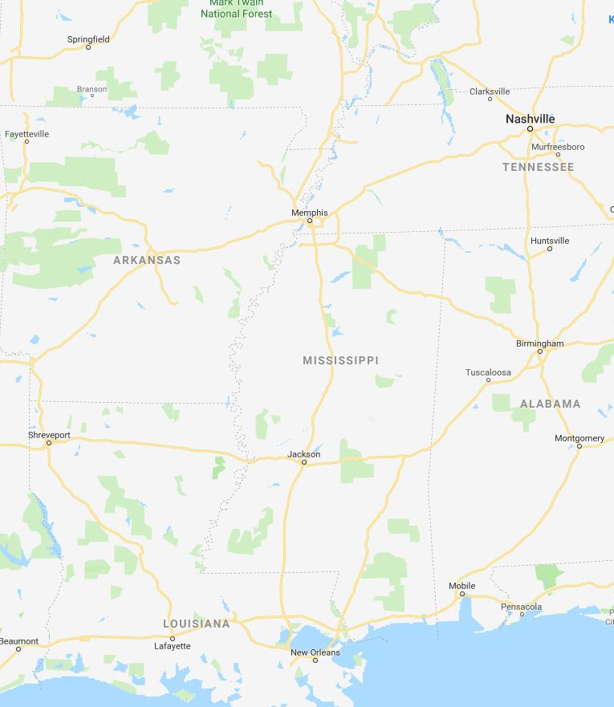
Ohio/Mississippi River Crest Watch
Created April 6 2021 @ 12:00 pm CDT
Lower Mississippi River Forecast Center weather.gov/lmrfc
NWSLMRFC
@NWSLMRFC
MS River at Caruthersville
OH River at Paducah
Current: 34.9’ MINOR
2 Days
Current: 39.6’ MINOR
Forecast:
Cresting and falling below MINOR on Saturday
Forecast:
Crested and falling below MINOR for tomorrow
2 Days
0.5 Day
MS River at Memphis
OH River at Cairo
Current: 31.6’ ACTION
Current: 46.5’ MINOR
Forecast:
Crest in ACTION at 31.7’ this evening
Forecast:
Crested and falling below MINOR on Saturday
MS River at Ark City
5 Days
MS River at Greenville
Current: 37.0’ MINOR
Current: 48.2’ MINOR
Forecast:
Fall below MINOR today
Forecast:
Crested and falling below MINOR on Thursday
2 Days
1 Day
MS River at Natchez
MS River at Vicksburg
Current: 52.3’ MODERATE
Current: 44.9’ MINOR
Forecast:
Cresting and remaining in MODERATE over the next 5 days
Forecast:
Cresting and remaining in MINOR over the next 5 days
2 Days
MS River at Baton Rouge
2 Days
MS River at New Orleans
Current: 37.8’ MINOR
Current: 14.2’
Forecast:
Cresting and remaining in MINOR over the next 5 days
Forecast:
Cresting over the next few days
Bonnet Carré Location
Morganza Location

