Slide 1
LMRFC Reference Slide For Crest Tables
LMRFC Forecasts Issued Morning of March 24, 2023
Lower Mississippi
RIVER FORECAST CENTER
Talking Points
The rain event has started and the middle Mississippi and Ohio Valleys has received 1 to 3 inches of rainfall. Another round of 1 to 4 inches of rainfall is expected from Arkansas extending northeast into the lower Ohio Valley.
Minor flooding is forecast for the lower Ohio River from Olmsted Lock and Dam, IL to Cairo, IL. Cairo, IL is forecast to crest at 43.0ft on March 31st. This crest would be about a foot less than the crest that occurred a couple of weeks ago.
Minor flooding continues on the lower Mississippi River at Red River Landing, LA and it should fall below flood stage early next week.
Rises from the lower Ohio River will start to move downstream on the lower Mississippi River and renewed minor flooding may be possible for portions of the lower Mississippi River.
The 16 day future rainfall guidance is showing higher crest levels on the lower Ohio River. The model is showing Cairo, IL cresting near 45.0ft for April 1st which is a couple of feet higher than the official forecast. This crest would be a foot higher than the crest earlier this month. The minor flooding is also extended through the second week of April.
Since we have another day of rainfall, continued adjustments will be made to the forecast in the coming days.

Slide 2
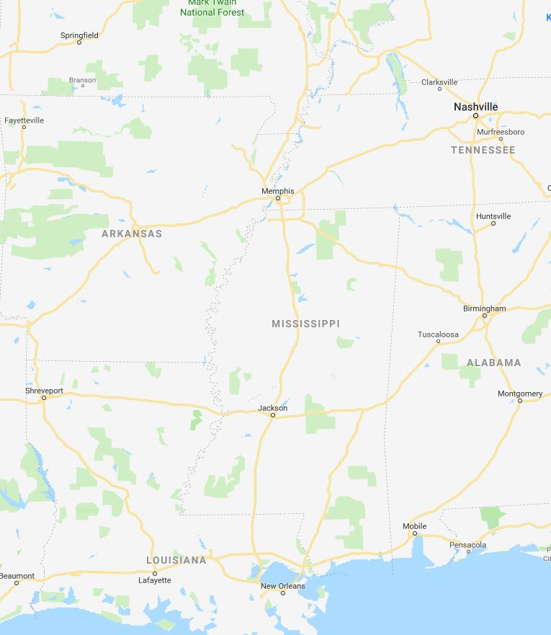
Ohio/Mississippi River Crest Watch
Created March 24 2023 @ 12:00 pm CDT
Lower Mississippi River Forecast Center weather.gov/lmrfc
NWSLMRFC
@NWSLMRFC
MS River at Caruthersville
OH River at Paducah
Current: 17.1’
2 Days
Current: 16.7’
Forecast:
Crest in MINOR at 32.0’
on Apr 1st
Forecast:
Crest in ACTION at 31.0’
on Mar 31st
2 Days
0.5 Day
MS River at Memphis
OH River at Cairo
Current: 12.4’
Current: 25.0’
Falling for a couple of days, then rises below flood stage over the next week
Forecast:
Forecast:
Crest in MINOR at 33.0’
on Mar 31st
MS River at Ark City
5 Days
MS River at Greenville
Current: 25.4’
Falling over the next few days, then rises below flood stage starting next week
Current: 36.6’ ACTION
Forecast
Forecast:
Falling below ACTION today, then rises above ACTION for late next week
2 Days
1 Day
MS River at Natchez
MS River at Vicksburg
Current: 46.9’ ACTION
Falls over the next week, then rises possibly to MINOR flood during the second week of April
Current: 37.5’ ACTION
Forecast:
Forecast:
Falling below ACTION by Sunday, then rises above ACTION for late next week
2 Days
MS River at Baton Rouge
2 Days
MS River at New Orleans
Current: 12.6’
Current: 34.0’ ACTION
Falling over the next week, then rises through the second week of April
Falls over the next week, then rises to near MINOR flood
during the second week of April
Forecast:
Forecast:
Bonnet Carré Location
Morganza Location

