Slide 1
LMRFC Reference Slide For Crest Tables
LMRFC Forecasts Issued Morning of March 22, 2023
Lower Mississippi
RIVER FORECAST CENTER
Talking Points
All locations on the bottom of the lower Mississippi River have crested and New Orleans, LA is starting to fall.
Minor flooding continues from Natchez, MS downstream to Red River Landing, LA. Minor flooding should end at Natchez, MS tomorrow and end at Red River Landing, LA by early next week.
Significant falls of 1 to 2 feet continue on the lower Mississippi River and have reached Greenville, MS. Significant falls should continue downstream over the next one two weeks.
The lower Ohio River has fallen almost 20ft from the peak which occurred on March 10th.
The weather models continue to show a heavy rain event over the middle Mississippi and lower Ohio Valleys for Thursday through Saturday and the official forecast is starting to show rises on the lower Ohio River starting on Sunday.
The 16 day future rainfall guidance continues to show minor flooding on the lower Ohio River. Today’s run is showing Cairo, IL cresting above 44.0 feet for March 31st and remaining above flood through the second week of April. This crest would be similar to the crest that occurred earlier this month.

Slide 2
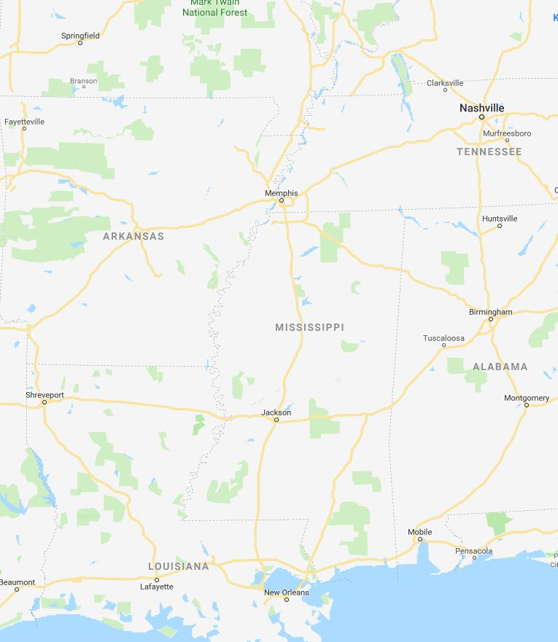
Ohio/Mississippi River Crest Watch
Created March 22 2023 @ 12:00 pm CDT
Lower Mississippi River Forecast Center weather.gov/lmrfc
NWSLMRFC
@NWSLMRFC
MS River at Caruthersville
OH River at Paducah
Current: 18.3’
2 Days
Current: 17.0’
Forecast:
Falling over the next 5 days
Forecast:
Falling over the next
5 days
2 Days
0.5 Day
MS River at Memphis
OH River at Cairo
Current: 14.8’
Current: 25.6’
Forecast:
Falling over the next
5 days
Forecast:
Falling over the next
5 days
MS River at Ark City
5 Days
MS River at Greenville
Current: 28.7’
Current: 39.8’ ACTION
Forecast
Falling over the next
5 days
Forecast:
Falling below ACTION by
Mon March 27th
2 Days
1 Day
MS River at Natchez
MS River at Vicksburg
Current: 48.3’ MINOR
Current: 39.4’ ACTION
Forecast:
Falling below MINOR by tomorrow and
falling over the next few days
Forecast:
Falling below ACTION by Sun March 26th
2 Days
MS River at Baton Rouge
2 Days
MS River at New Orleans
Current: 34.9’ ACTION
Current: 13.1’
Forecast:
Forecast:
Falling over the next 5 days
Near Crest and remaining above ACTION over the next 5 days
Bonnet Carré Location
Morganza Location

