Slide 1

LMRFC Reference Slide For Crest Tables
LMRFC Forecasts Issued Morning of March 20, 2023
Lower Mississippi
RIVER FORECAST CENTER
Talking Points
All locations on the bottom of the lower Mississippi River are either near crest or cresting now.
Minor flooding continues from Natchez, MS downstream to Red River Landing, LA. Minor flooding should end at all locations by early next week.
Significant falls of 1 to 2 feet continue on the lower Ohio River and have reached Arkansas City, AR on the lower Mississippi River. Significant falls should continue downstream over the next couple of weeks.
The weather models are hinting at a heavy rain event over the middle Mississippi and lower Ohio Valleys for later this week into the weekend.
The 16 day future rainfall guidance is showing another rise on the lower Ohio River for the first week of April. Today’s run is showing Cairo, IL cresting near 40.5 feet for April 5th – April 6th. Minor flooding would be possible on the lower Ohio River and portions of the lower Mississippi River.

Slide 2


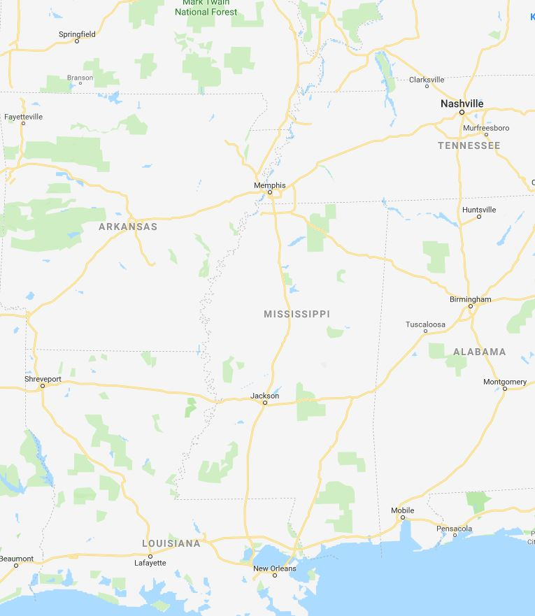


Ohio/Mississippi River Crest Watch
Created March 20 2023 @ 12:00 pm CDT
Lower Mississippi River Forecast Center weather.gov/lmrfc
NWSLMRFC
@NWSLMRFC
MS River at Caruthersville
OH River at Paducah
Current: 20.7’
2 Days
Current: 19.6’
Forecast:
Falling over the next 5 days
Forecast:
Falling over the next
5 days
2 Days
0.5 Day
MS River at Memphis
OH River at Cairo
Current: 18.0’
Current: 28.3’
Forecast:
Falling over the next
5 days
Forecast:
Falling over the next
5 days
MS River at Ark City
5 Days
MS River at Greenville
Current: 31.9’
Current: 43.0’ ACTION
Forecast
Falling over the next
5 days
Forecast:
Falling and remaining above ACTION over the next 5 days
2 Days
1 Day
MS River at Natchez
MS River at Vicksburg
Current: 49.0’ MINOR
Current: 40.7’ ACTION
Forecast:
Cresting in MINOR and slow falls over the next few days
Forecast:
Slow falls and remaining above ACTION over the next 5 days
2 Days
MS River at Baton Rouge
2 Days
MS River at New Orleans
Current: 34.9’ ACTION
Current: 13.3’
Forecast:
Near Crest and remaining above ACTION over the next 5 days
Forecast:
Near crest with tidal fluctuations
Bonnet Carré Location
Morganza Location

