Slide 1
LMRFC Reference Slide For Crest Tables
LMRFC Forecasts Issued Morning of March 15, 2023
Lower Mississippi
RIVER FORECAST CENTER
Talking Points
On the lower Mississippi River, cresting conditions are approaching Vicksburg, MS and all locations should reach crest levels by early next week.
Minor flooding is occurring from Natchez, MS downstream to Red River Landing, LA. Minor flooding should end at Natchez, MS for early next week and Red River Landing, LA will remain above flood stage through next week.
The lower Ohio River has fallen 5 to 6 feet over the past 5 days and all locations are below flood stage. The lower Ohio River will continue to fall through the weekend.
The 16 day future rainfall guidance shows continued falls on the lower Ohio River through early next week and then steady conditions through the end of the month. The model is showing another rise for the first week of April but the rises are well below flood levels.

Slide 2
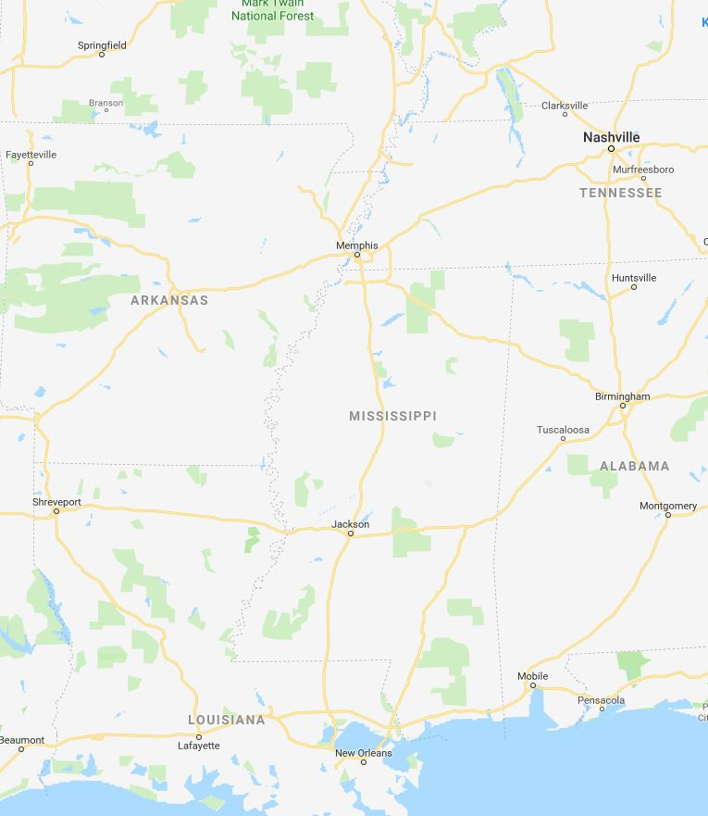
Ohio/Mississippi River Crest Watch
Created March 15 2023 @ 12:00 pm CDT
Lower Mississippi River Forecast Center weather.gov/lmrfc
NWSLMRFC
@NWSLMRFC
MS River at Caruthersville
OH River at Paducah
Current: 29.7’ ACTION
2 Days
Current: 30.7’
Forecast:
Falling below ACTION Today
Forecast:
Falling over the next
5 days.
2 Days
0.5 Day
MS River at Memphis
OH River at Cairo
Current: 27.6’
Current: 38.3’ ACTION
Forecast:
Falling over the next
5 days
Forecast:
Falling below ACTION on March 18th
MS River at Ark City
5 Days
MS River at Greenville
Current: 34.6’
Current: 44.8’ ACTION
Forecast
Cresting now and falling over the next 5 days
Forecast:
Cresting now and falling over the next 5 days
2 Days
1 Day
MS River at Natchez
MS River at Vicksburg
Current: 48.0’ MINOR
Current: 40.8’ ACTION
Forecast:
Crest in MINOR at
48.5’ on March 17th
Forecast:
Crest in ACTION near 41.0’ on March 16th
2 Days
MS River at Baton Rouge
2 Days
MS River at New Orleans
Current: 32.9’ ACTION
Current: 12.1’
Forecast:
Crest in ACTION at
34.0’ on March 19th
Forecast:
Crest at 12.7’ on
March 20th
Bonnet Carré Location
Crest Location

