Slide 1
LMRFC Reference Slide For Crest Tables
LMRFC Forecasts Issued Morning of April 6, 2023
Lower Mississippi
RIVER FORECAST CENTER
Talking Points
The crest on the lower Mississippi River is approaching Arkansas City, AR.
Minor flooding continues at Red River Landing, LA and it is forecast for Natchez, MS by this weekend. The lower Mississippi River should crest at all locations by the end of next week.
Over the next several days, a minor rise is forecast on the lower Ohio River and crests should remain below flood levels.
The rises on the lower Ohio River will only slow down the recessions on the lower Mississippi River.
One to three inches of rainfall is expected over the lower Mississippi Valley during the next few days. This rainfall will not significantly impact the crests on the lower Mississippi River.
The 16 day future rainfall guidance is very close to the official forecast. The stages on the 16 day guidance are slightly higher and no additional flooding is forecast for the remainder of April.

Slide 2
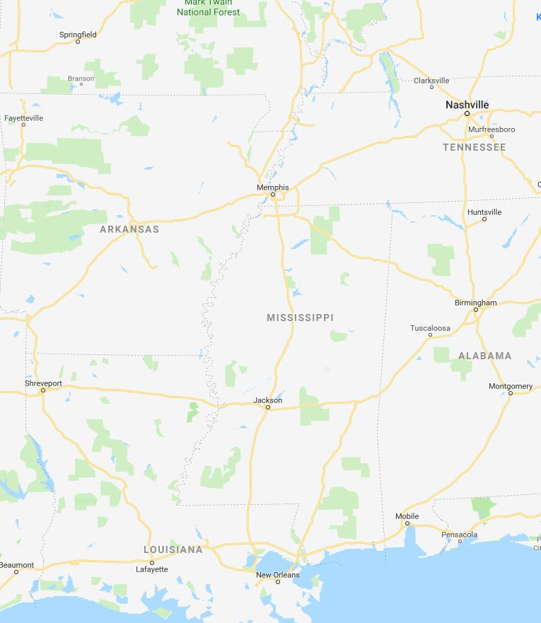
Ohio/Mississippi River Crest Watch
Created April 6 2023 @ 12:00 pm CDT
Lower Mississippi River Forecast Center weather.gov/lmrfc
NWSLMRFC
@NWSLMRFC
MS River at Caruthersville
OH River at Paducah
Current: 28.1’ ACTION
2 Days
Current: 31.7’ ACTION
Forecast:
Steady for a few days and then falls next week
Forecast:
Crest in ACTION at 32.5’
on Apr 8th
2 Days
0.5 Day
MS River at Memphis
OH River at Cairo
Current: 25.3’
Current: 38.7’ ACTION
Forecast:
Steady for a few days and
then falls next week
Forecast:
Crest in ACTION at 39.5’ on Apr 9th
MS River at Ark City
5 Days
MS River at Greenville
Current: 33.6’
Current: 44.2’ ACTION
Forecast
Near crest and slow falls
over the next few days
Forecast:
Near crest and slow falls over the next few days
2 Days
1 Day
MS River at Natchez
MS River at Vicksburg
Current: 47.3’ ACTION
Current: 40.1’ ACTION
Forecast:
Crest in MINOR at 48.5’ on Apr 9th
Forecast:
Crest in ACTION near 40.5’ on Apr 8th
2 Days
MS River at Baton Rouge
2 Days
MS River at New Orleans
Current: 11.9’
Current: 30.3’ ACTION
Slow rises with tidal fluctuations and crest near 12.5’ for Apr 12th
Forecast:
Crest in ACTION near 34.5’ on
Apr 11th
Forecast:
Bonnet Carré Location
Crest Location

