Slide 1
LMRFC Reference Slide For Crest Tables
LMRFC Forecasts Issued Morning of May 27, 2021
Lower Mississippi
RIVER FORECAST CENTER
Talking Points
All locations on the lower Mississippi River have fallen below flood stage now.
Heavy rain over the Missouri and middle Mississippi Rivers will generate another rise on the Mississippi River above the junction with the Ohio River. Cape Girardeau, MO on the middle Mississippi River is expected to crest at 30.0ft during the middle of next week. This crest is several feet below flood stage.
Since the lower Ohio River is currently at low flow conditions, the rise from the middle Mississippi River will generate rises of a few feet at Cairo, IL. The minor rises will continue downstream over the next couple of weeks and slowly dissipate as it reaches the lower end of the Mississippi River.
The 16 day future rainfall guidance also shows a minor rise on the lower Ohio River for the middle of next week and dampens the falls through the second and third week of June.

Slide 2
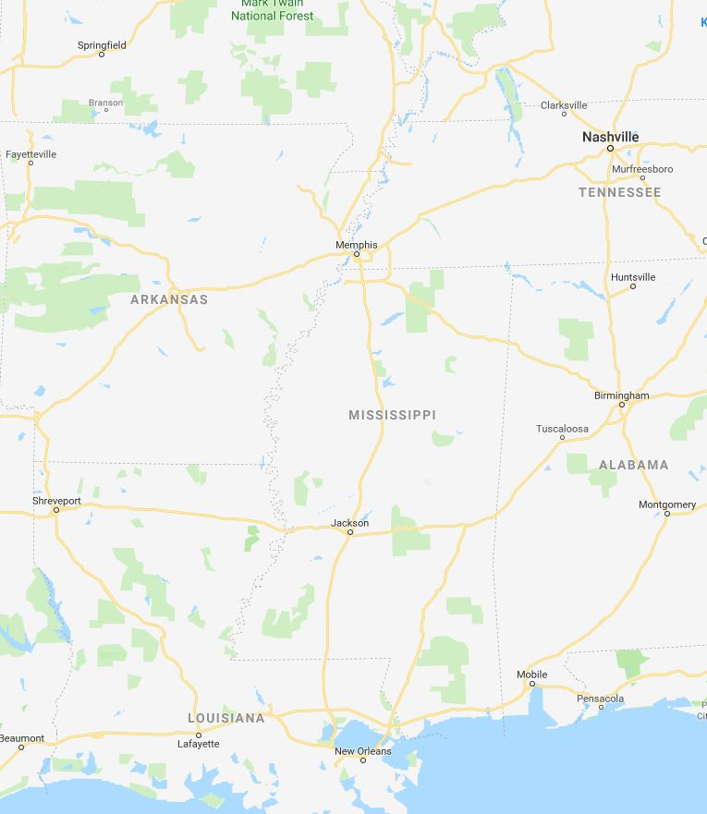
Ohio/Mississippi River Crest Watch
Created May 27 2021 @ 12:00 pm CDT
Lower Mississippi River Forecast Center weather.gov/lmrfc
NWSLMRFC
@NWSLMRFC
MS River at Caruthersville
OH River at Paducah
Current: 17.1’
2 Days
Current: 14.9’
Forecast:
Continue to fall over the next several days
Forecast:
Steady with minor fluctuations over the next several days
2 Days
0.5 Day
MS River at Memphis
OH River at Cairo
Current: 11.8’
Continue to fall over the next several days, minor rises are expected early next week.
Current: 24.4’
Forecast:
Continue to fall over the next several days
Forecast:
MS River at Ark City
5 Days
MS River at Greenville
Current: 23.5’
Current: 34.7’
Forecast:
Continue to fall over the next several days
Forecast:
Continue to fall over the next several days
2 Days
1 Day
MS River at Natchez
MS River at Vicksburg
Current: 43.1’ ACTION
Current: 32.8’
Forecast:
Continue to fall slowly over the next
several days
Forecast:
Continue to fall over the next several days
2 Days
MS River at Baton Rouge
2 Days
MS River at New Orleans
Current: 30.4’ ACTION
Current: 10.9’
Forecast:
Forecast:
Slow falls over the next several days
Fall below ACTION on Sunday
Bonnet Carré Location
Morganza Location

